Slide 1


Slide 2


DIABETES PREDICTION
”DIABETES RISK ASSESSMENT USING MACHINE LEARNING TECHNIQUES THROUGH A COMPARATIVE
STUDY”
BY -
SHREYA DATTA

Slide 3
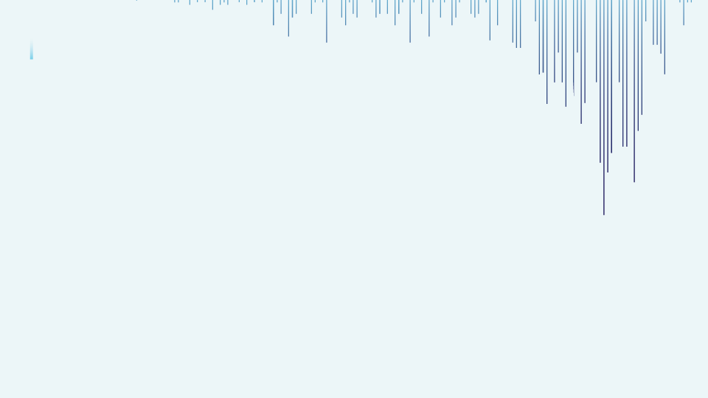
SOURCE:
https://www.kaggle.com/datasets/anupriyaparakale/diabetes-detection
The dataset used in this project is originally from NIDDK(National Institute of Diabetes and Digestive and Kidney Diseases).Predicting diabetes in patients based on diagnostic measurements and thereby, evaluating the predictive performance of different machine learning algorithms in predicting the outcomes and identifying trends for diabetes management and early personalized treatment , based on the following records of the patients :
Pregnancies (Number of times a female has conceived)
Glucose (Blood Sugar Level)-mMol/L
Blood Pressure (Diastolic Blood Pressure)-mm Hg
PROBLEM STATEMENT:

Slide 4
Skin Thickness (Fold Thickness Of Triceps Skin)-mm
Insulin (2 hours Serum Insulin Intake)-mL
Body Mass Index (Body Mass / Body
Weight)- kg
Diabetes Pedigree Function (Hereditary Carrier Cases)/
(Genetic Influence)
Age (Age Of Females)- years
So, these are all the independent variables, on the basis of which, I would utilize the different machine learning algorithms to predict the target variable , thereby, to solve this disease prediction problem under health care domain.

Slide 5
WHY AM I SOLVING THE PROBLEM?
For 3 foremost reasons I am performing this problem of
diabetes prediction.
EARLY IDENTIFICATION OF THE DISEASE- acts as a boon to save a
large count of lives before they actually develop this disease.
PLANNING THE PERSONALIZED TREATMENTS- Our predictive models actually
helps the healthcare professionals to plan a proper personalized treatments
for the patients who are suffering or at the likelihood of developing the
disease.
ALLOCATION OF RESOURCES- Looking at the likelihood of developing this disease in a person, the healthcare professionals tend to take some measures of allocation like , educational campaign, preventive measures, in a way that a patient gets benefitted by that.

Slide 6
CHALLENGES FACED BY THE HEALTH CARE
DOMAIN TO PREDICT THE DISEASE OF DIABETES:
Data Availability
Data Quality And Standardization
Data Privacy And Security
Feature Selection And Dimensionality
Imbalanced Data
Model Interpretability

Slide 7
HOW MY MODEL IS GOING TO HELP:
Accurate Predictions
Early Prevention
Improved Patient Outcomes
Research And Insights
Continuous Learning And Improvement
Personalized Approach
🌴 Data Analysis and Visualization on Ecommerce Dataset
This is the largest retail e-commerce orders dataset from Pakistan. It contains half a million transaction records from March 2016 to August 2018. The data was collected from various e-commerce merchants as part of a research study. Further details can be found on the following link and also download csv file from the following link

Slide 8
STEPS REQUIRED TO BE FOLLOWED:
EDA (Exploratory Data Analysis)
Preprocessing
Train Test Split
Algorithm
Evaluation

Slide 9
EDA : (Exploratory data analysis)
df.head() = It fetches the 1st 5 rows and 9 columns.
df.tail()= It fetches the last 5 rows and 9 columns.
df.shape = It shows how many rows and columns are
there in the dataset.
df.columns =It fetches the names of all the columns (keys)
in the dataset.
df.dtypes = It fetches the data types of each columns (Integer, Float, String, Boolean).
df.info()=It shows full information of the dataset transformed into a data frame( number of columns, column labels, column data types, number of non-null values, range index, memory usage).

Slide 10
df.describe ()= It gives the description of the data
in the data frame, it basically gives the summary of
a descriptive statistics of a data frame ;
(count, mean, standard deviation, max, 25% percentile
(1st quartile), 50% percentile ( median) , 75% percentile
(3rd quartile) and the minimum ) values of all the features.
df.unique()= It gives a list of all the unique values in a column.
df.nunique() = It fetches the total count of unique values in each column.
df.isnull().sum()= It shows the total count of missing values in each column.
df.rename()= This function is used to rename the columns.

Slide 11
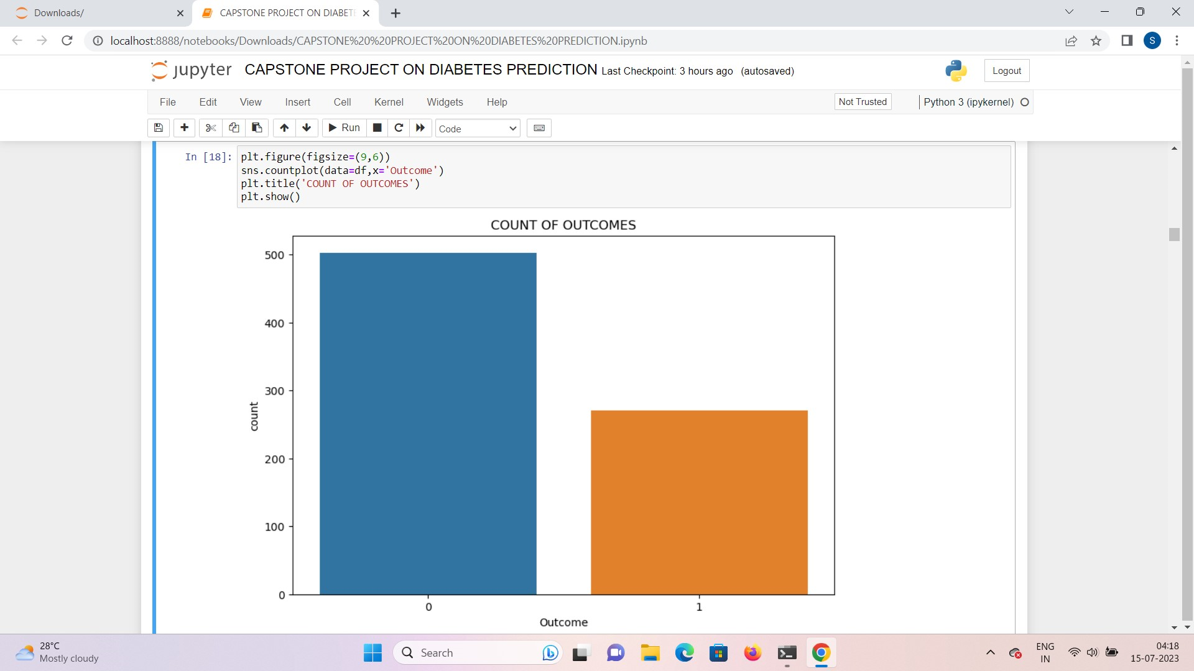
DATA VISUALISATIONS:
COUNT PLOT:
With the help of a Count Plot,
I can interpret the total count of each class of the target variable , ‘Outcome’, where 0 represents the Non-Diabetic Condition whereas , 1 represents the Diabetic Condition of female patients in the dataset. From the visualization I can say that the count of non-diabetic patients is more than the diabetic ones.

Slide 12
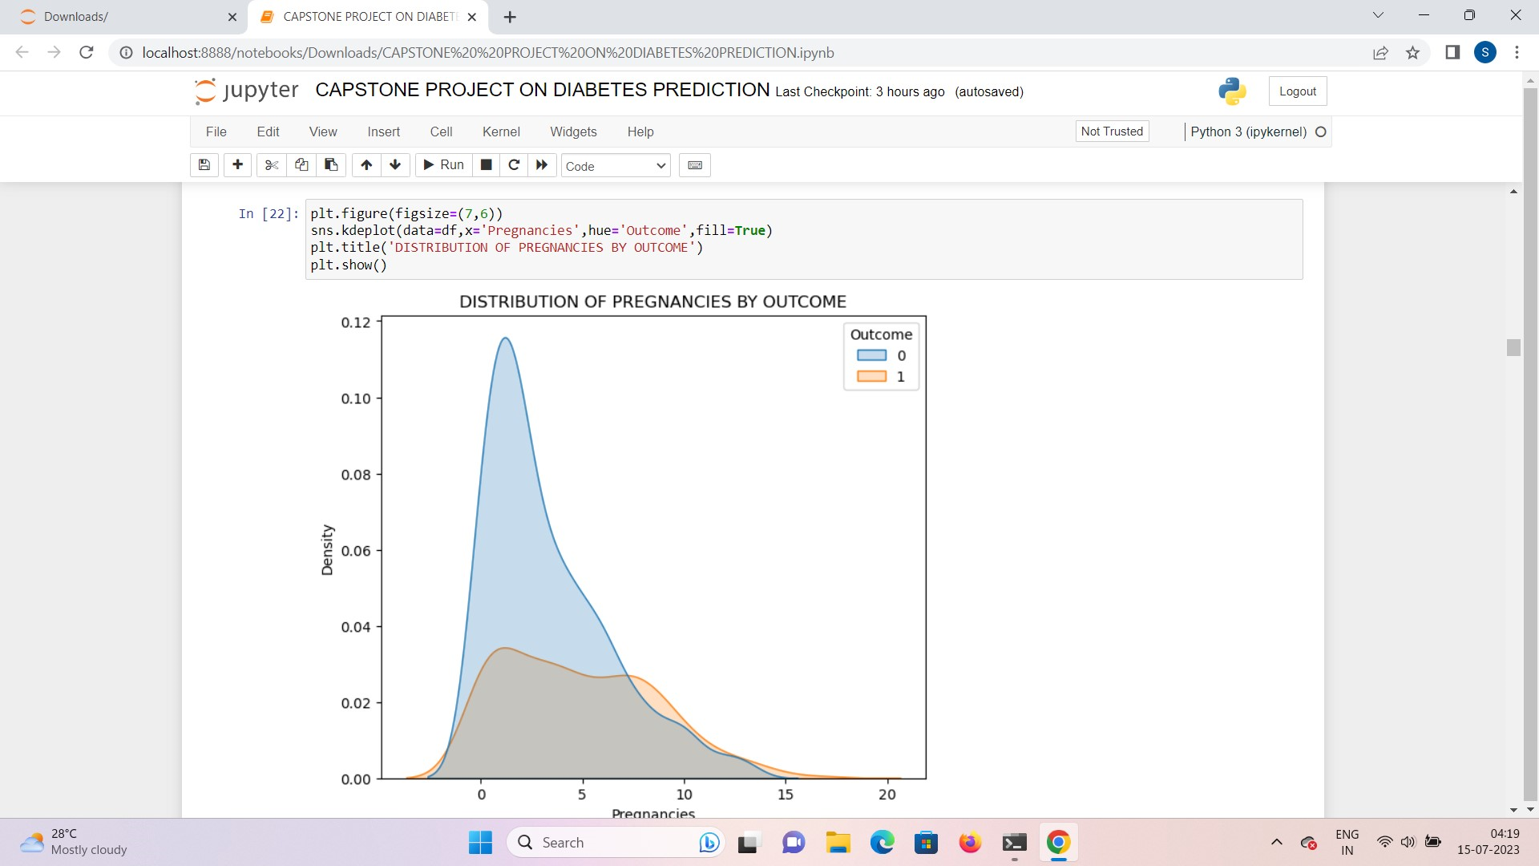
DENSITY PLOT (KERNEL
DENSITY PLOT):
Density plot displays the distribution of the variables in a dataset, similar to that of histogram , but its better that it, as it displays the shape of a distribution and accordingly, it also gives some statistical inferences through the plot, like , here, the distribution of both diabetic and non-diabetic females are right skewed.

Slide 13
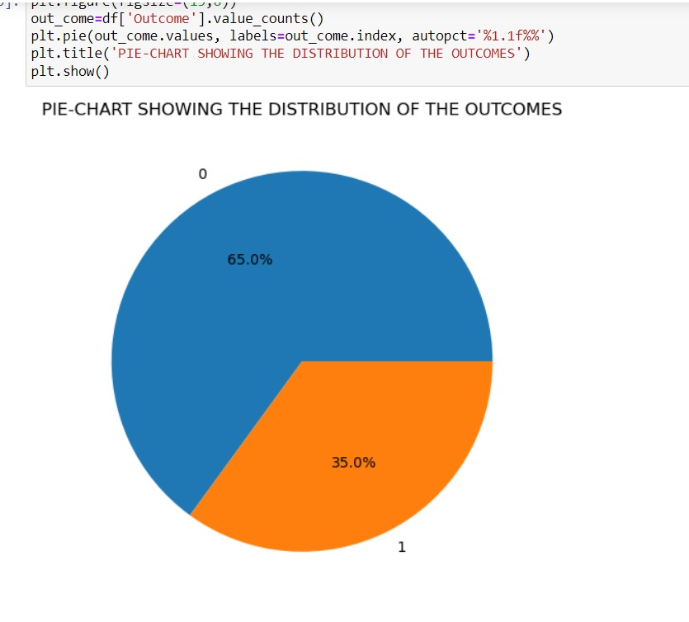
PIE-CHART:
The datapoints are displayed as a percentage of the whole pie . It shows the size of the each elements which is also called wedges according to their percentages. From this visualization , I can draw the interpretation, that the percentage of non-diabetic females are more (65%) in the dataset, as compared to those, who are diabetic in nature (35%).

Slide 14
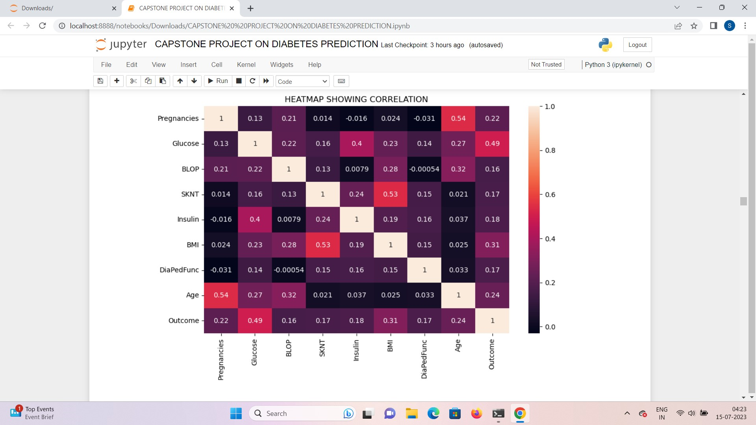
HEAT MAP:
Heat map helps to visualize
the values of Correlation
Matrix . Here, the bright red
values define that the 2
variables are perfectly
correlated to each other,
holding positive correlation
with each other, that is,
both the variables are moving
in the similar direction ,
perfectly explaining each
other such as :
Pregnancies with Age(0.54)
Glucose with Insulin (0.4)
Skin Thickness with Body Mass
Index (0.53).

Slide 15
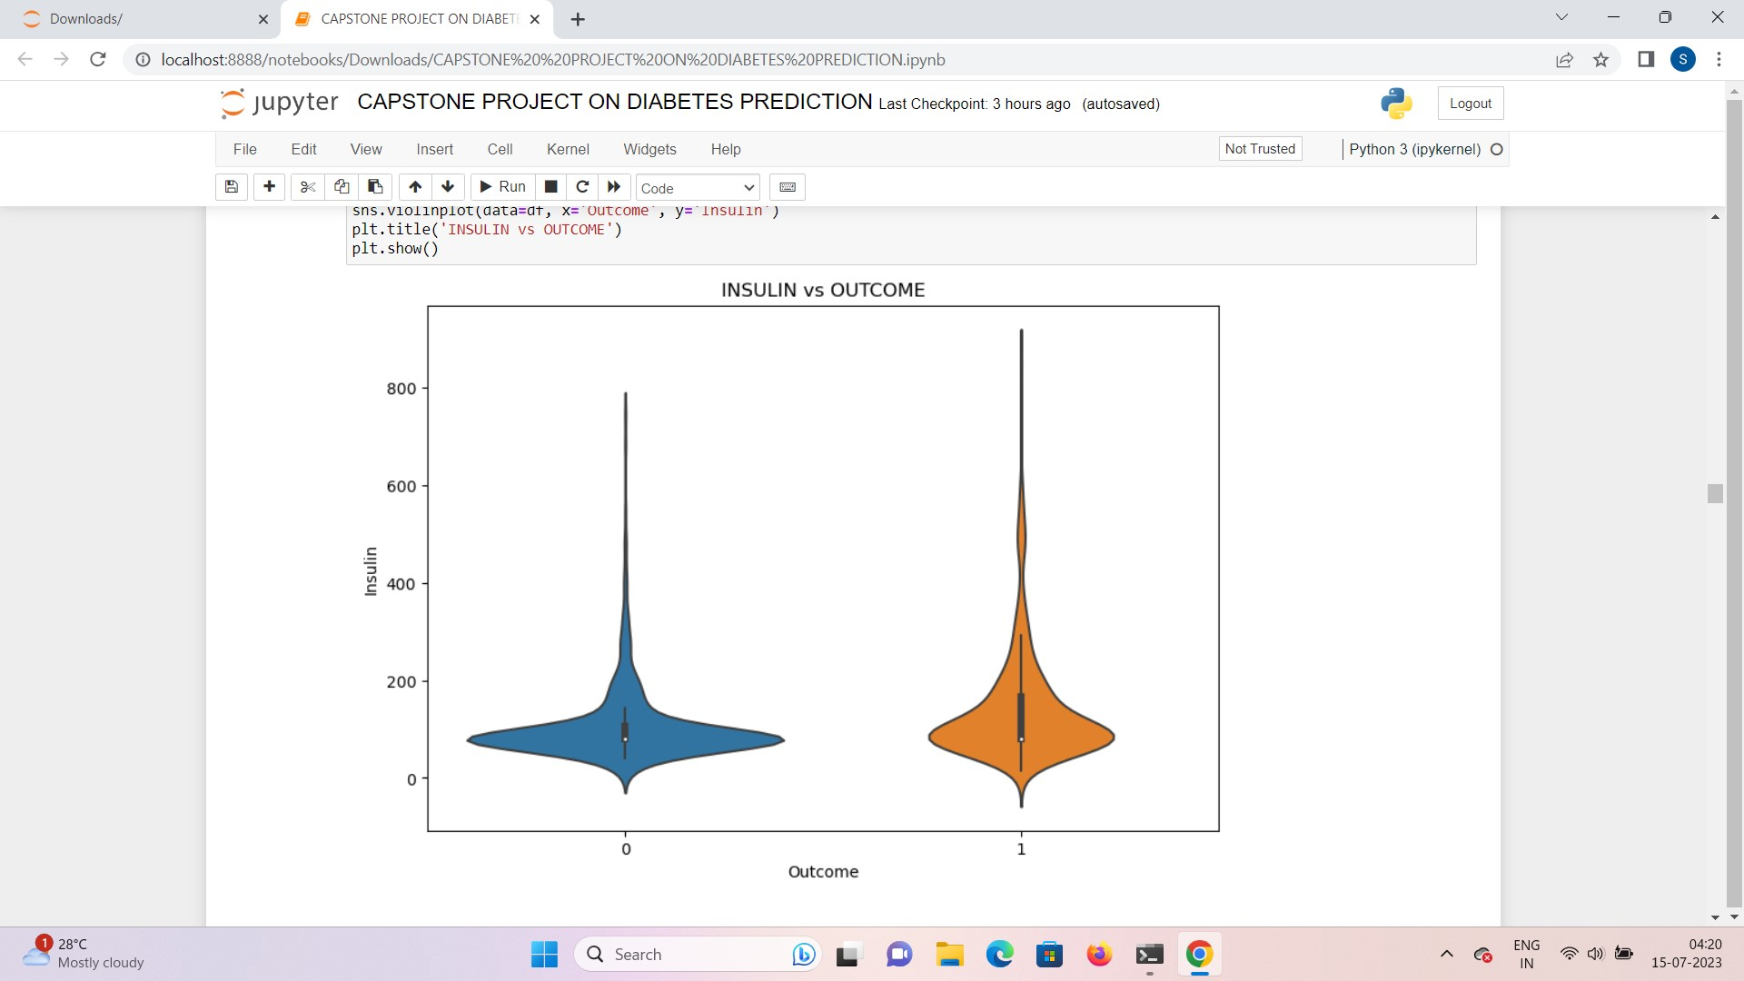
VIOLIN PLOT :
The violin plot works similar to the box plot and kernel density plot. Here , we can visualize four of the following:
females with non-diabetic conditions are more in number who have Insulin level in the range of
0-200 mL , as compared to the females with diabetic condition. That means, the density of females are more in the non-diabetic category as it is more wide in this range of Insulin.
Whereas, we can also see that the median value of Insulin level is more in the diabetic category as compared to the non-diabetic one.
There are also outliers present in this plot which is more in diabetic category.
Lastly, as we can see that both the violins are well-separated , it means that , the feature , ‘Insulin’ holds a potential relationship with the target variable, ‘Outcome’ , for diabetes prediction.

Slide 16
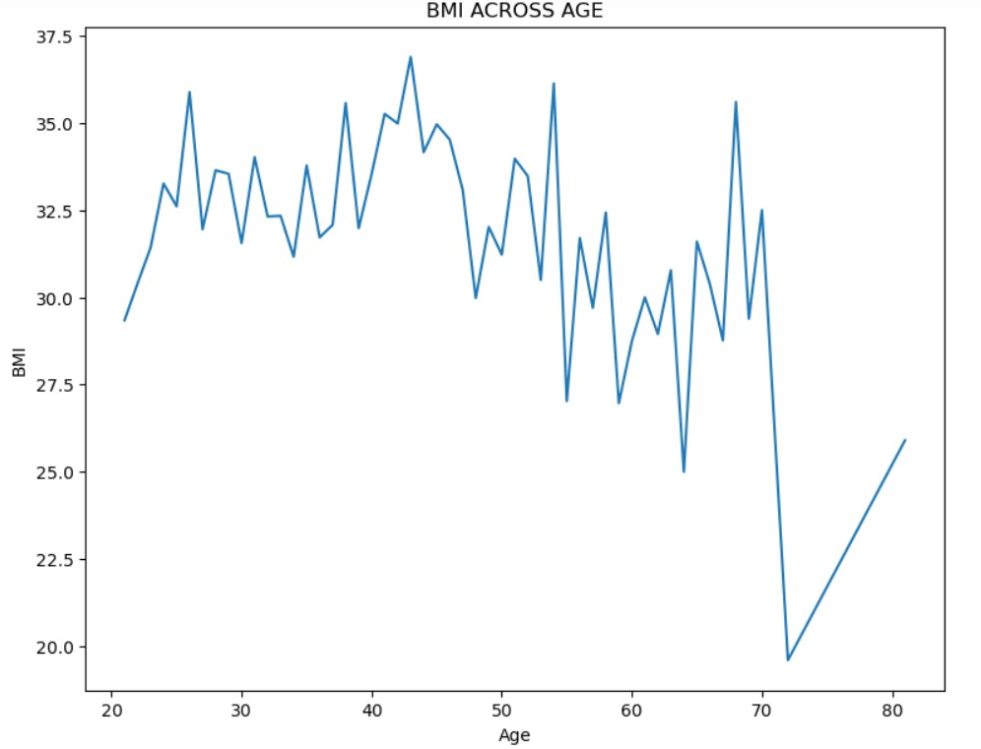
LINE PLOT :
It explains the relationship between 2 or multiple variables. Here, as we can that the Body Mass Index holds a positive correlation with the Age , hence, as we can see that at the Age of 71, BMI has a got a sudden decrease , but after that again BMI is gradually getting increased along with the increase in an Age , Therefore, it is interpreted that BMI holds a positive correlation with Age.

Slide 17
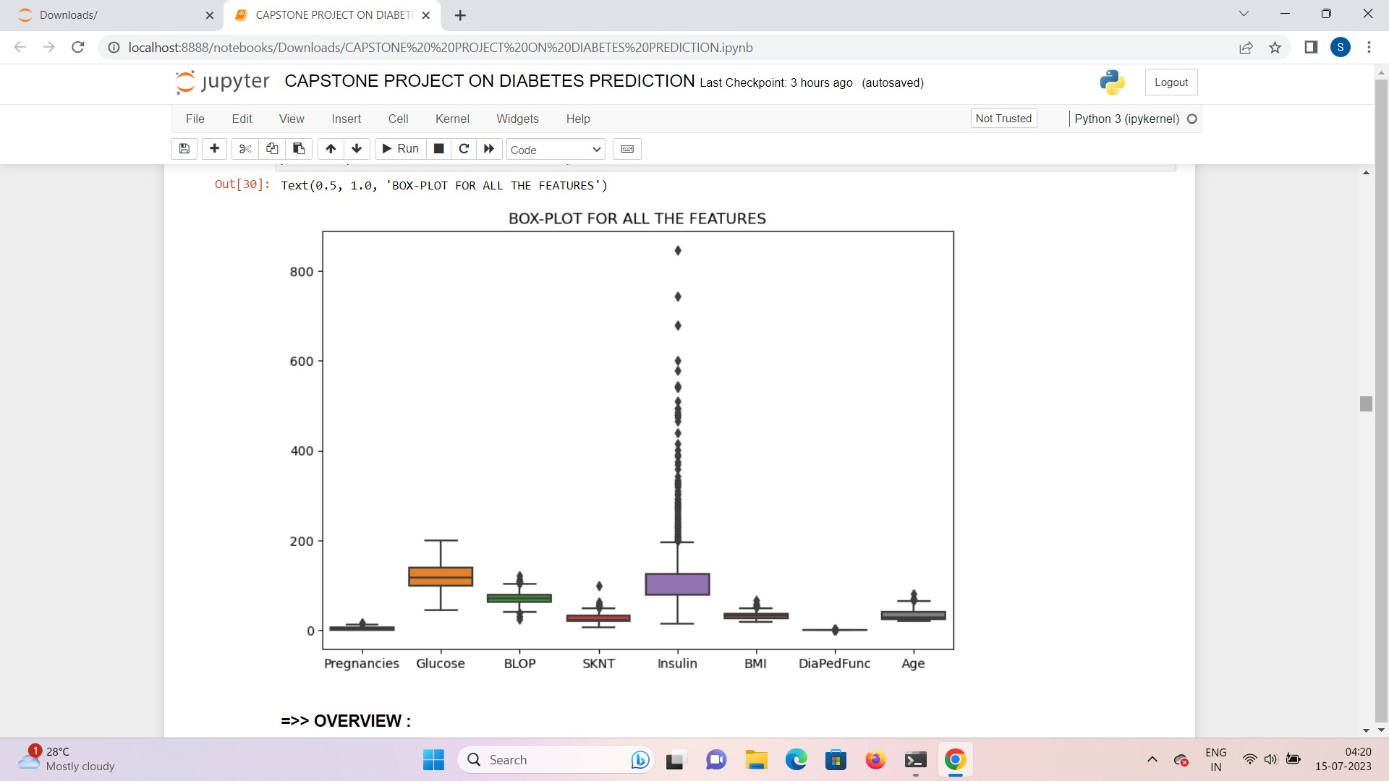
BOX PLOT :
It displays the summary of each and every independent variables along with their outliers. From Box Plot or Whisker Plot, we come to know about the statistical inferences of each and every independent variables. Here, It is showing that most of the features are having outliers and Insulin is the one with the highest number of outliers among all the other variables, in the dataset.

Slide 18
PREPROCESSING:
REMOVAL OF THE OUTLIERS
DATA TRANSFORMATION AND SCALING
(FEATURE ENGINEERING)
SPLITTING THE DATA INTO X AND Y
CONTROLLING RANDOMNESS OF THE SPLIT

Slide 19
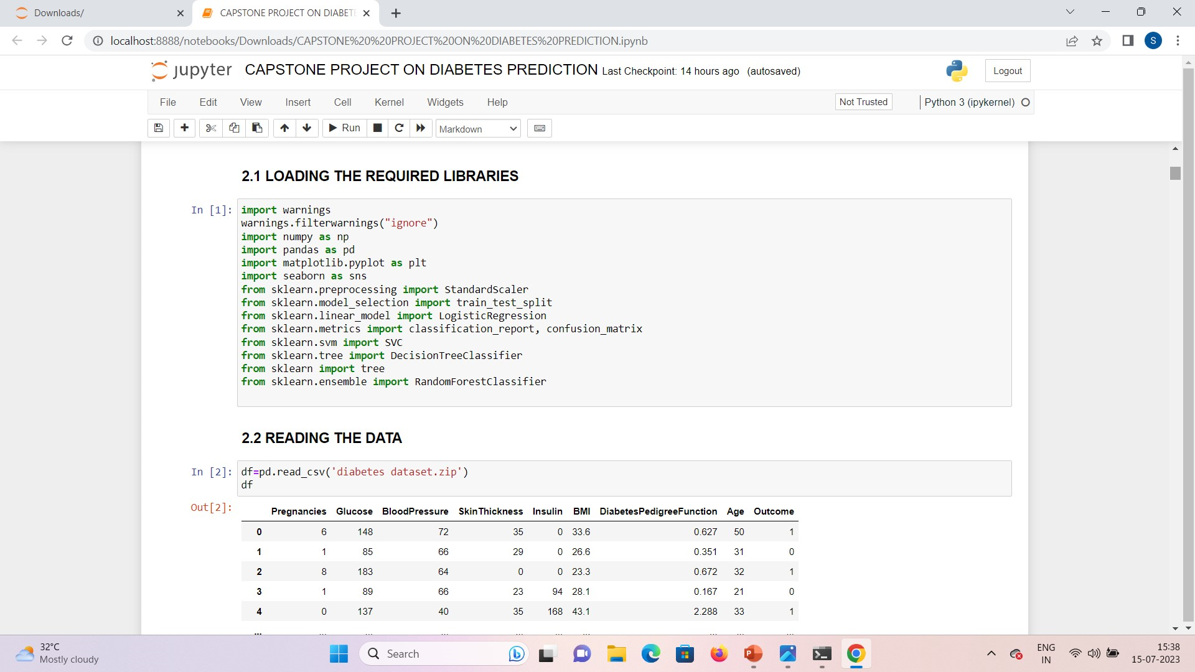
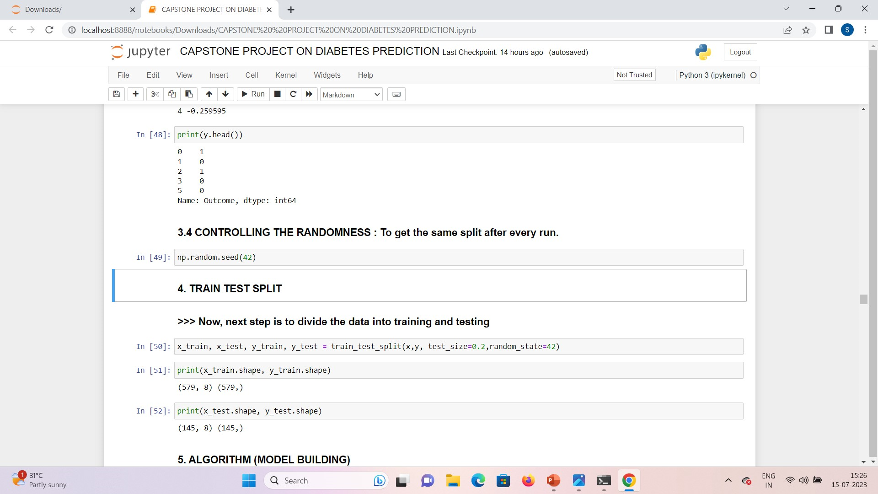
TRAIN TEST SPLIT :
Divide the data into training and testing

Slide 20
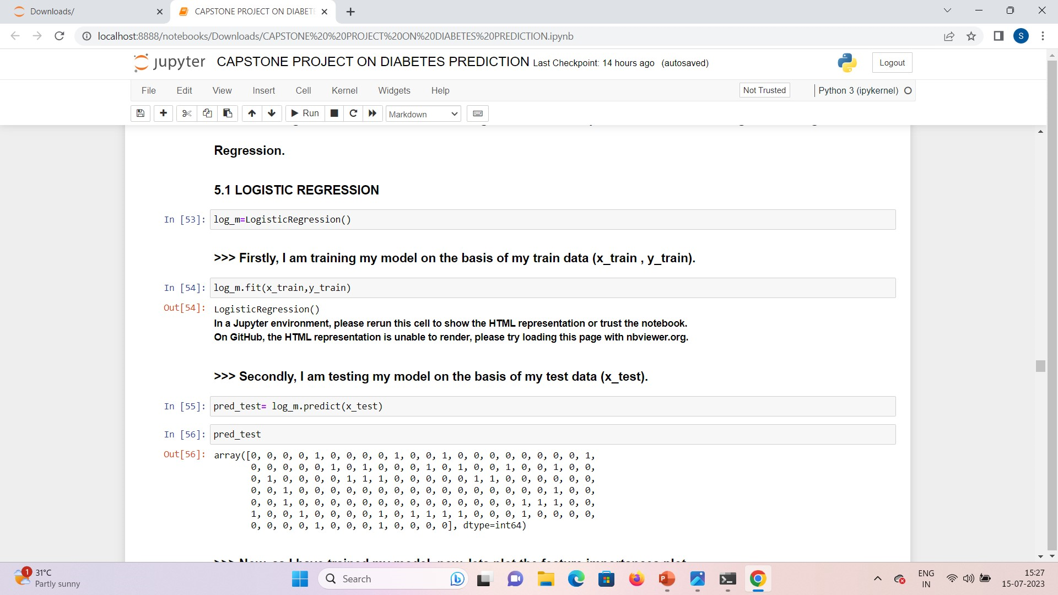
MODEL BULDING:
LOGISTIC REGRESSION:

Slide 21
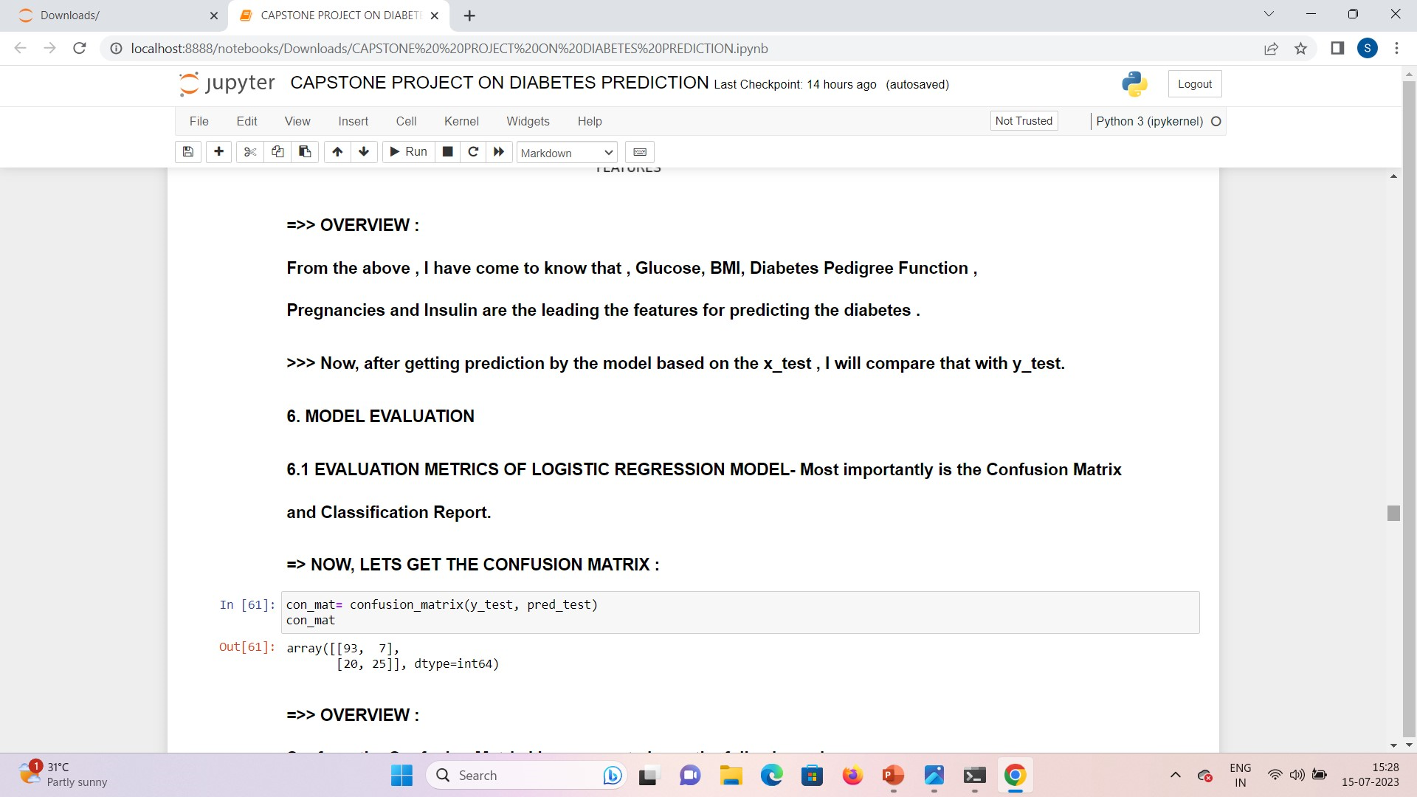
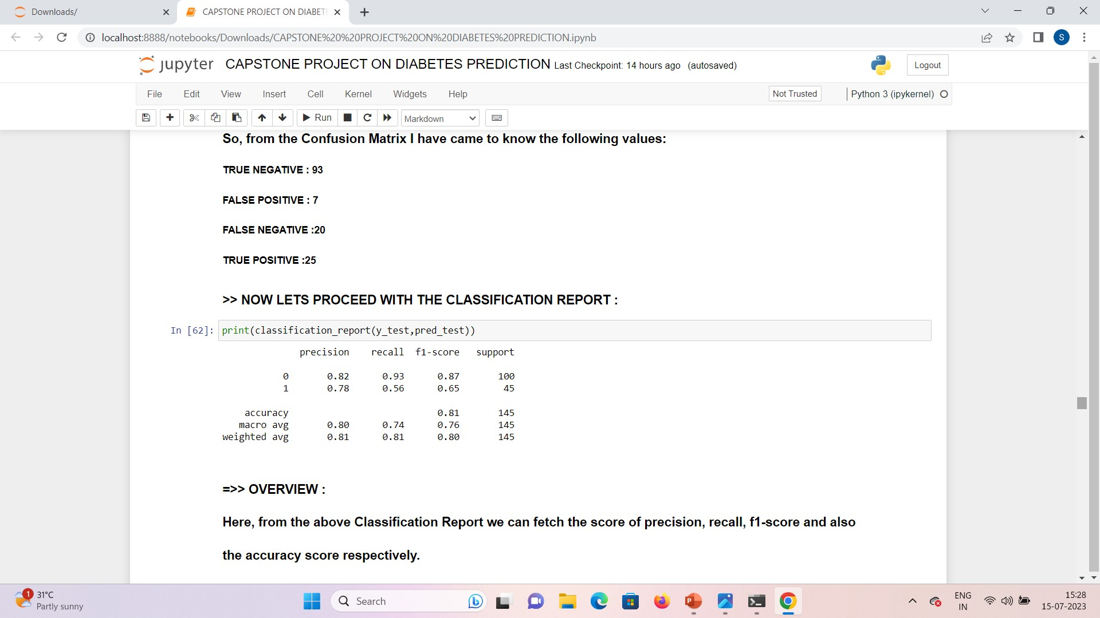




MODEL EVALUATION:
CONFUSION
MATRIX
TN
93
FP
7
FN
20
TP
25

Slide 22
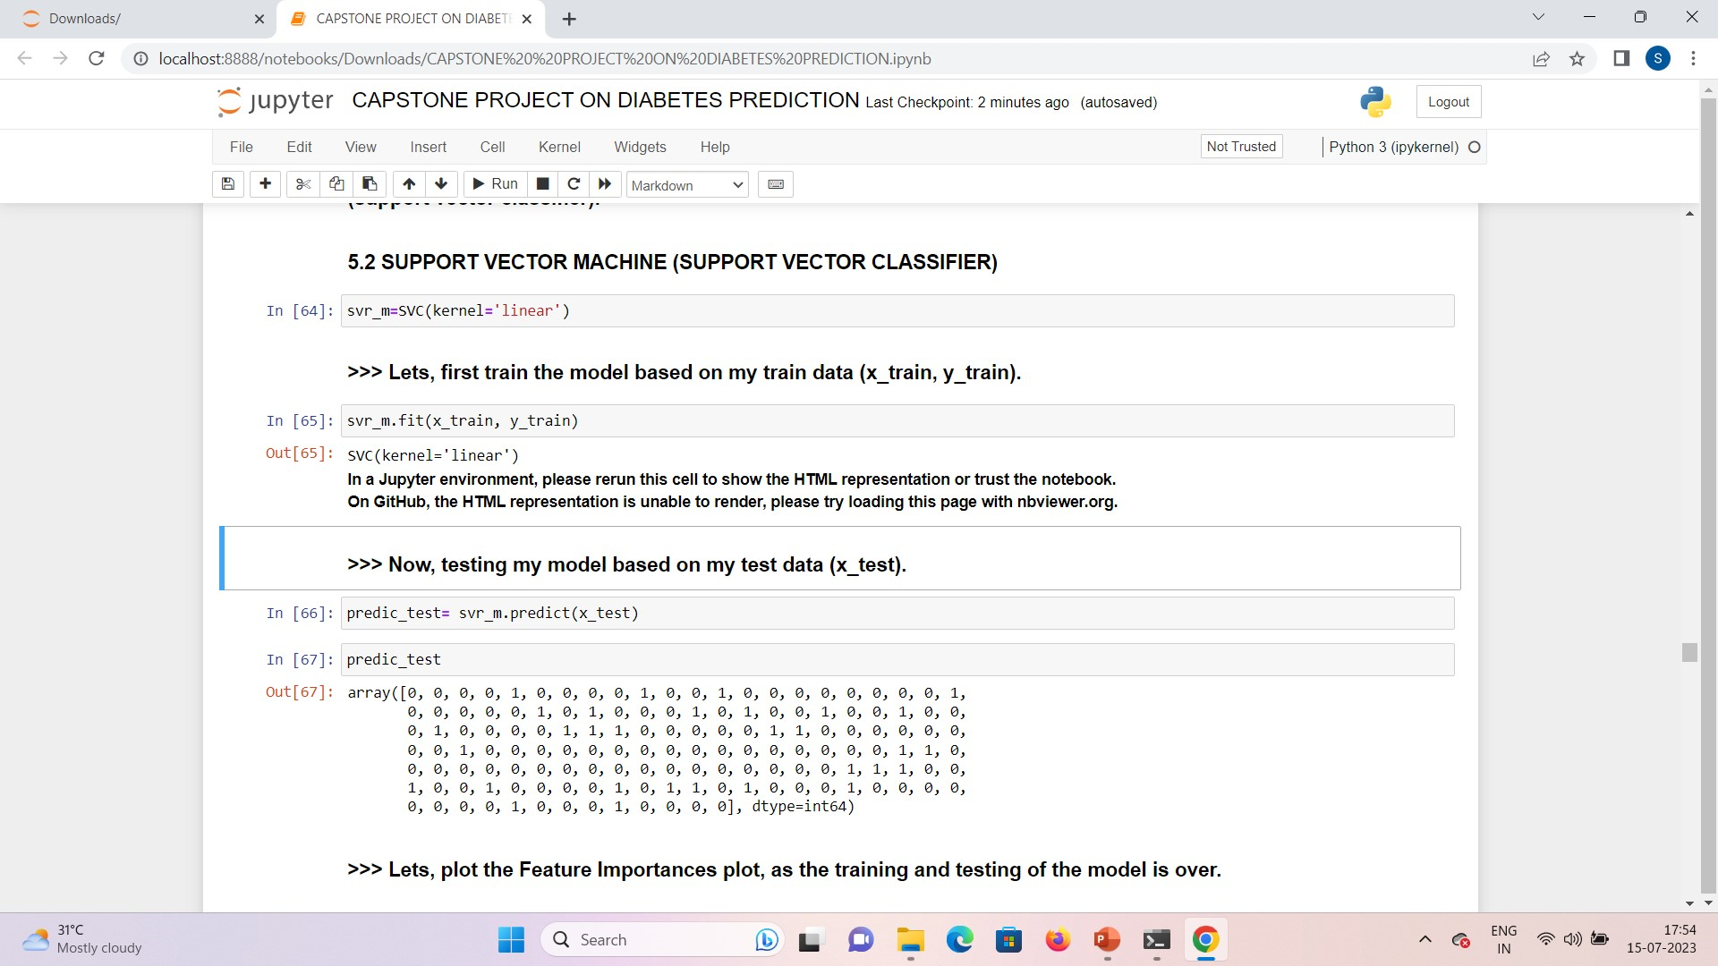
MODEL BUILDING :
SUPPORT VECTOR MACHINE:

Slide 23
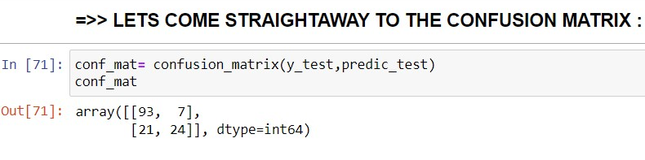
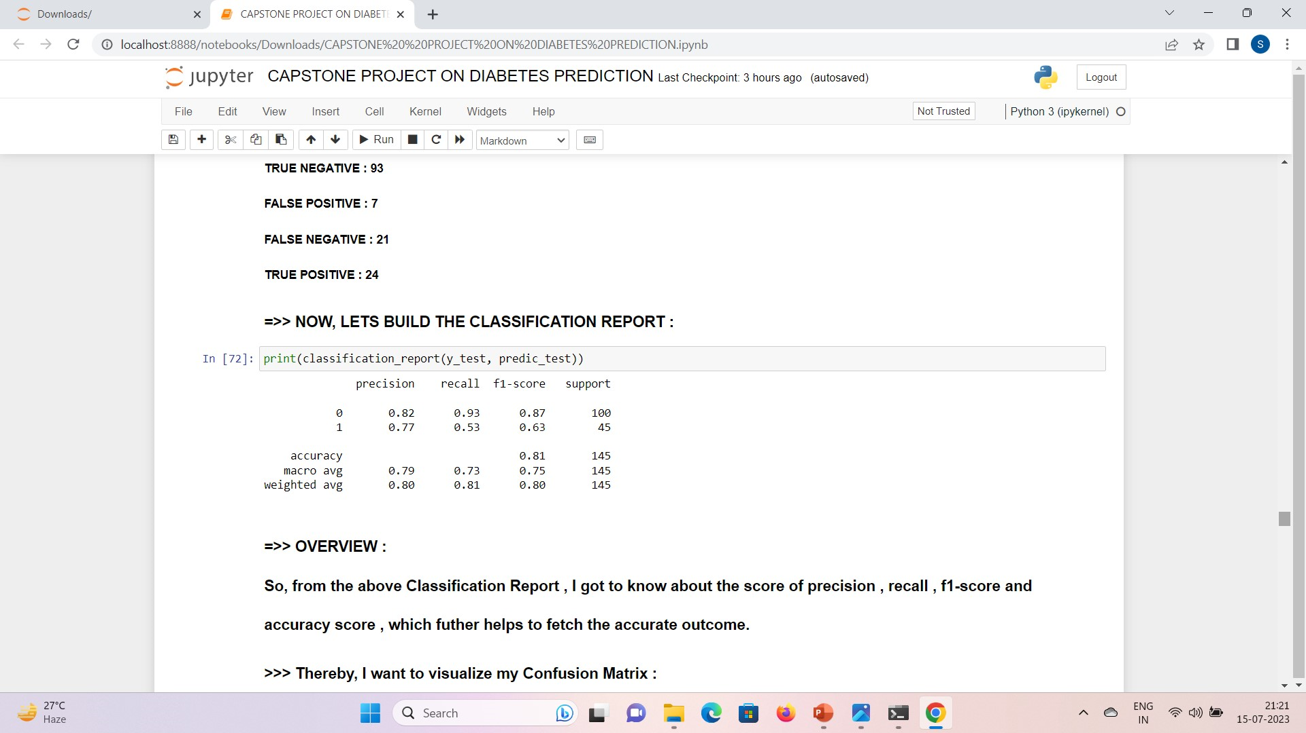




MODEL EVALUATION:
CONFUSION
MATRIX
TN
93
FP
7
FN
21
TP
24

Slide 24
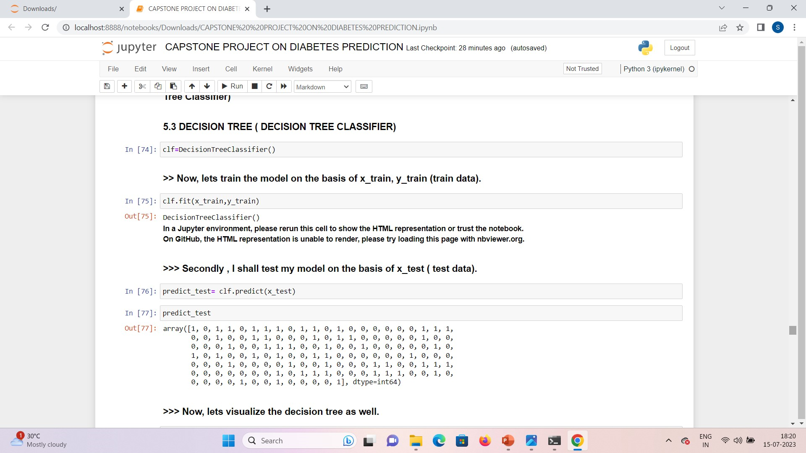
MODEL BUILDING:
DECISION TREE:

Slide 25
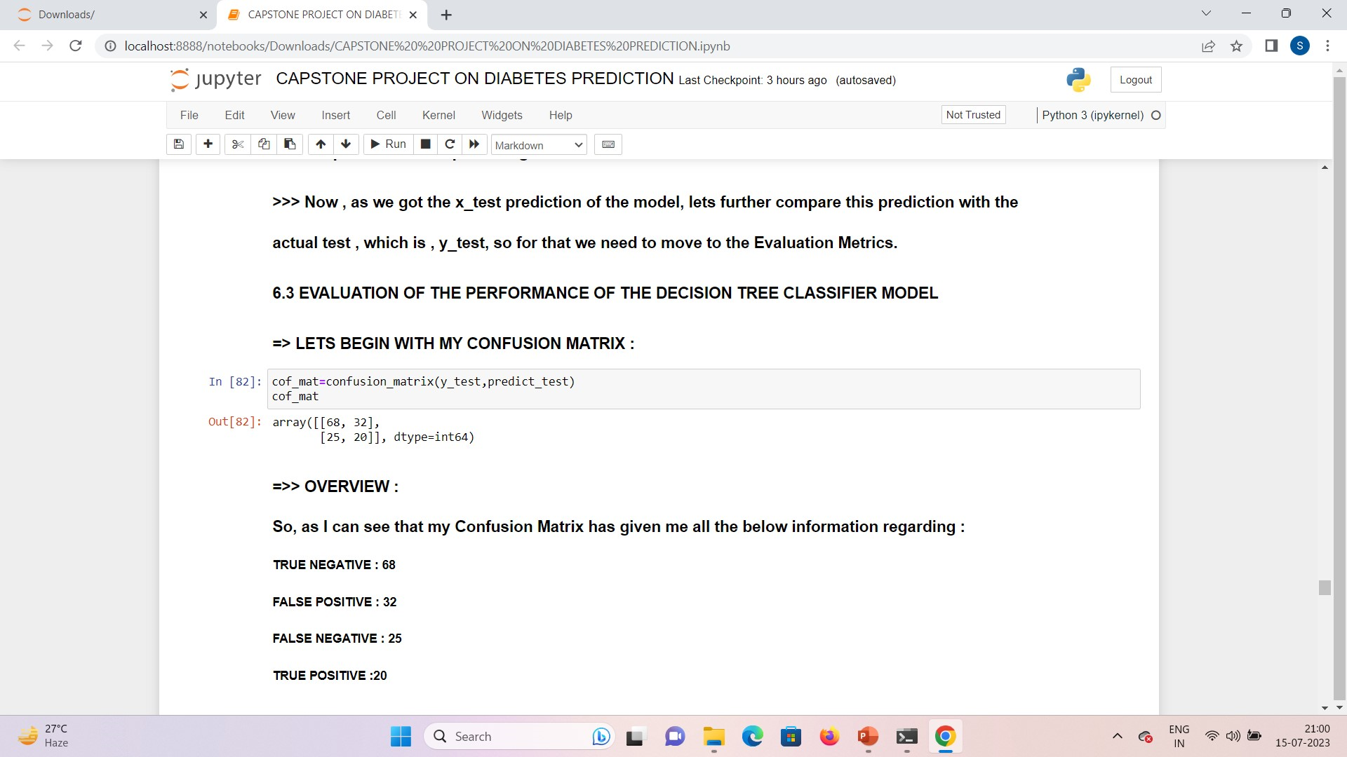
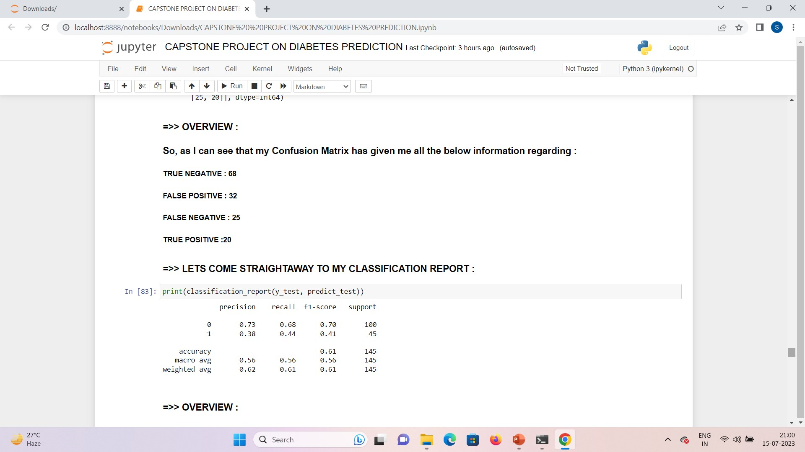
MODEL EVALUATION:
CONFUSION
MATRIX
TN
68
FP
32
FN
25
TP
20

Slide 26
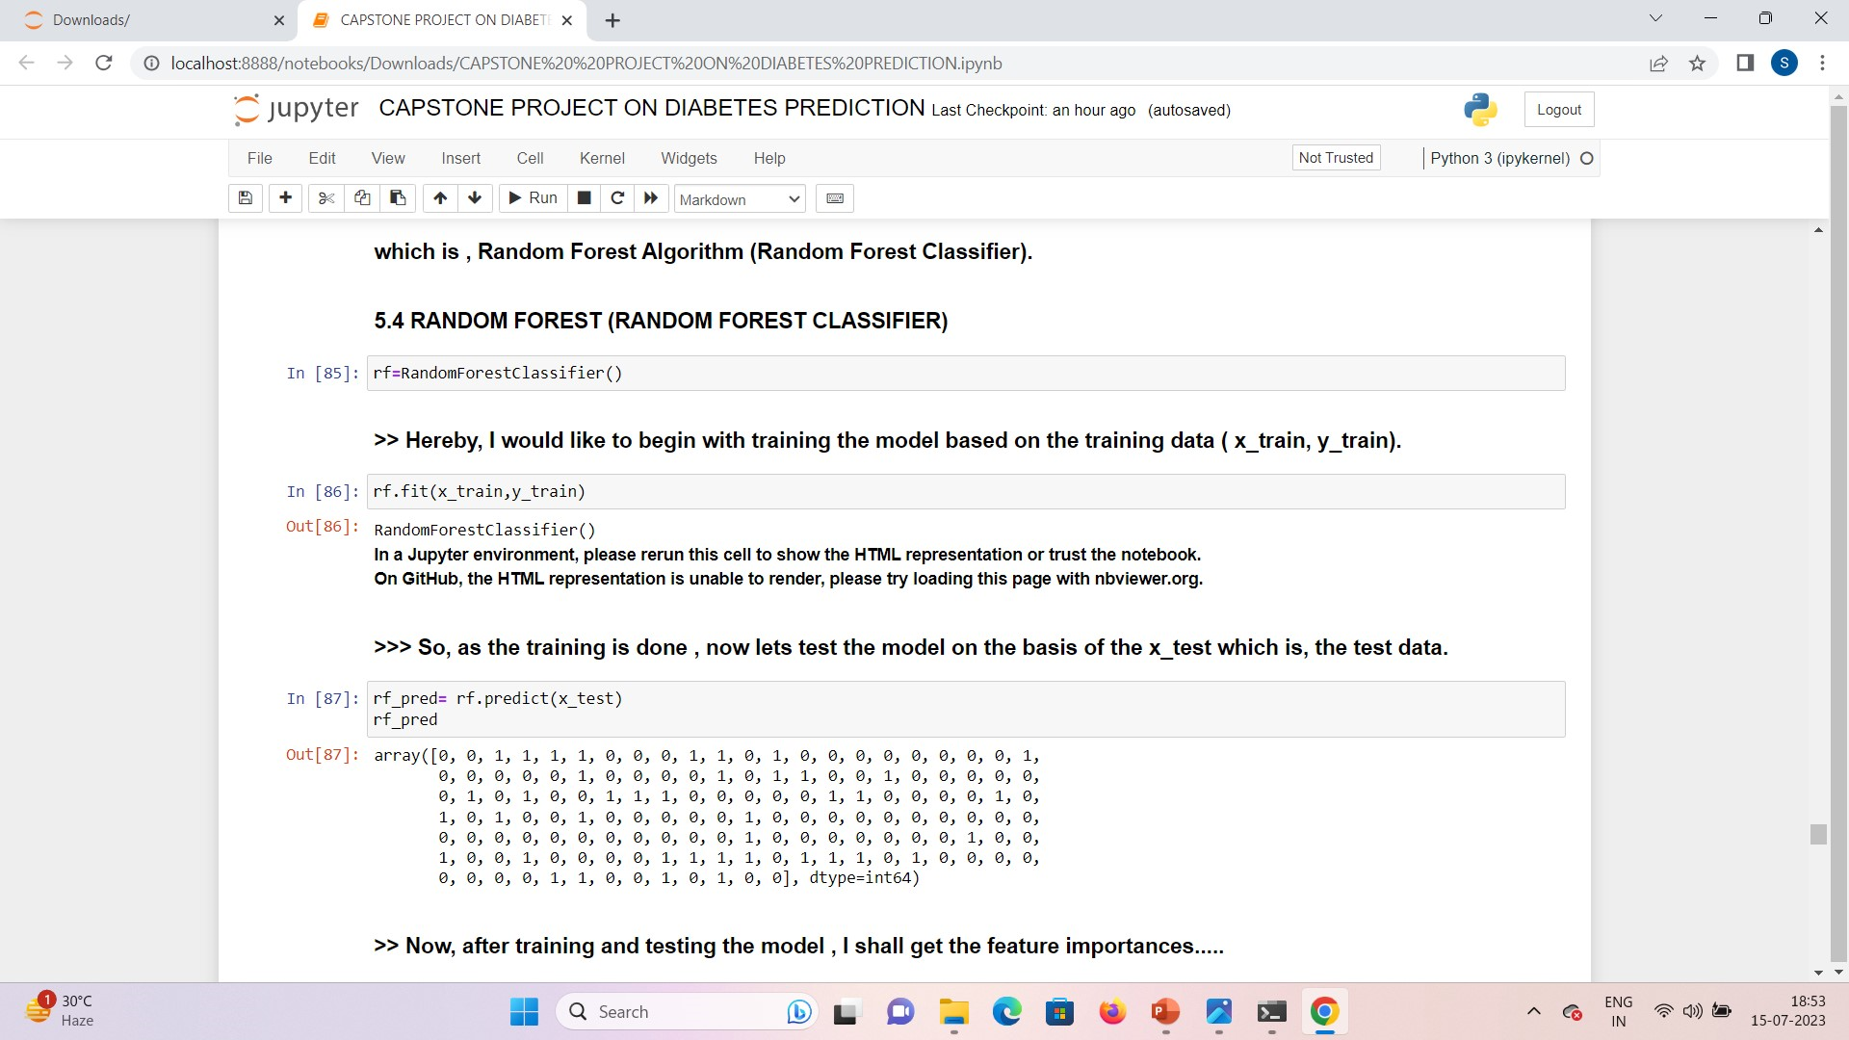
MODEL BUILDING:
RANDOM FOREST CLASSIFIER:

Slide 27
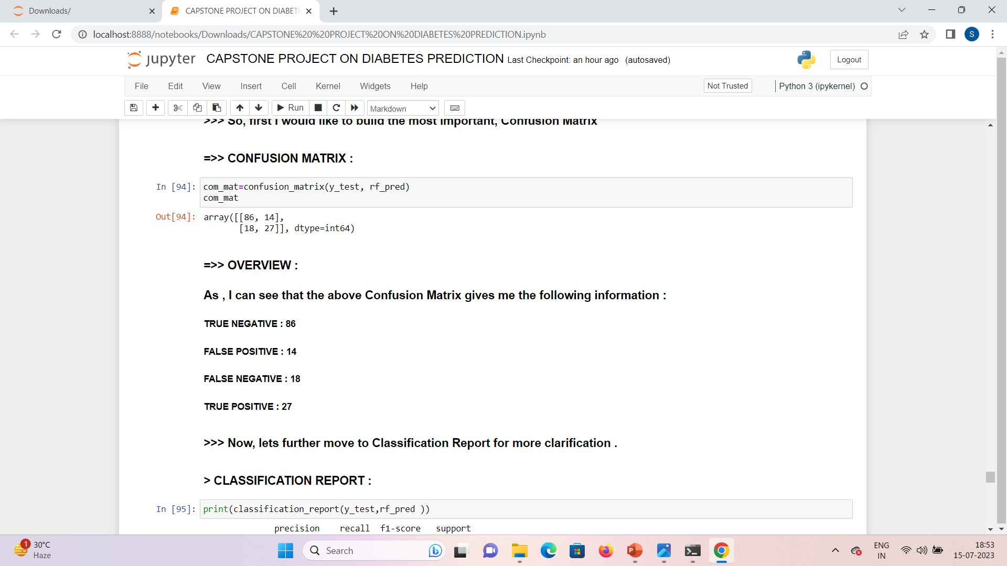
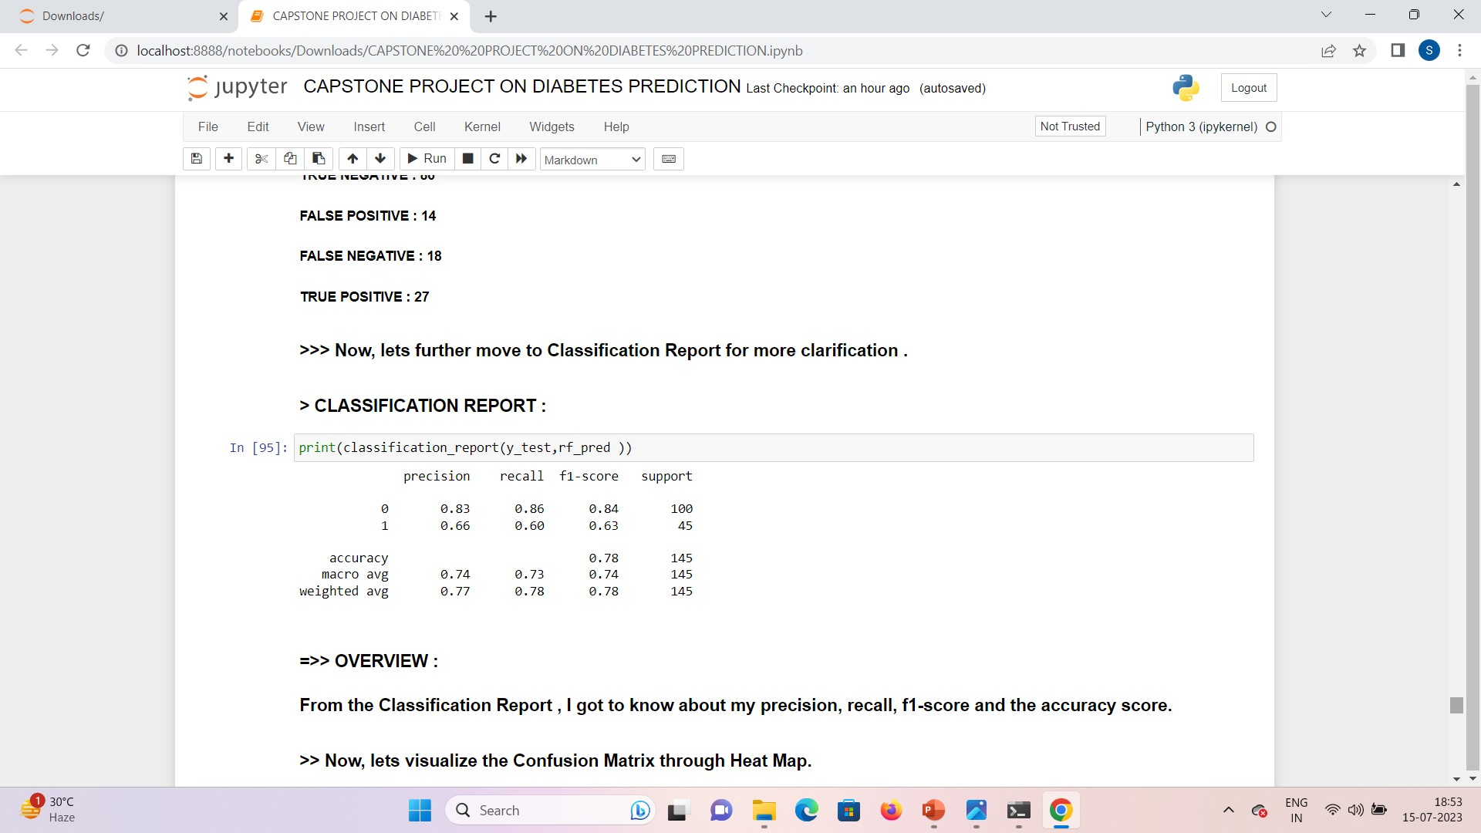
MODEL EVALUATION:
CONFUSION
MATRIX
TN
86
FP
14
FN
18
TP
27

Slide 28
COMPARISON TABLE OF THE MODEL PERFORMANCE :
Sl. No. | MODELS | PRECISION | RECALL | F-1 SCORE | ACCURACY
1. | LOGISTIC REGRESSION | 0.78 | 0.56 | 0.65 | 0.81
2. | SUPPORT VECTOR CLASSIFIER | 0.77 | 0.53 | 0.63 | 0.81
3. | DECISION TREE CLASSIFIER | 0.38 | 0.44 | 0.41 | 0.61
4. | RANDOM FOREST CLASSIFIER | 0.66 | 0.60 | 0.63 | 0.78
RANDOM FOREST CLASSIFIER IS THE BEST MODEL WITH THE HIGHEST RECALL SCORE AMONG ALL THE 4 MODELS.

Slide 29
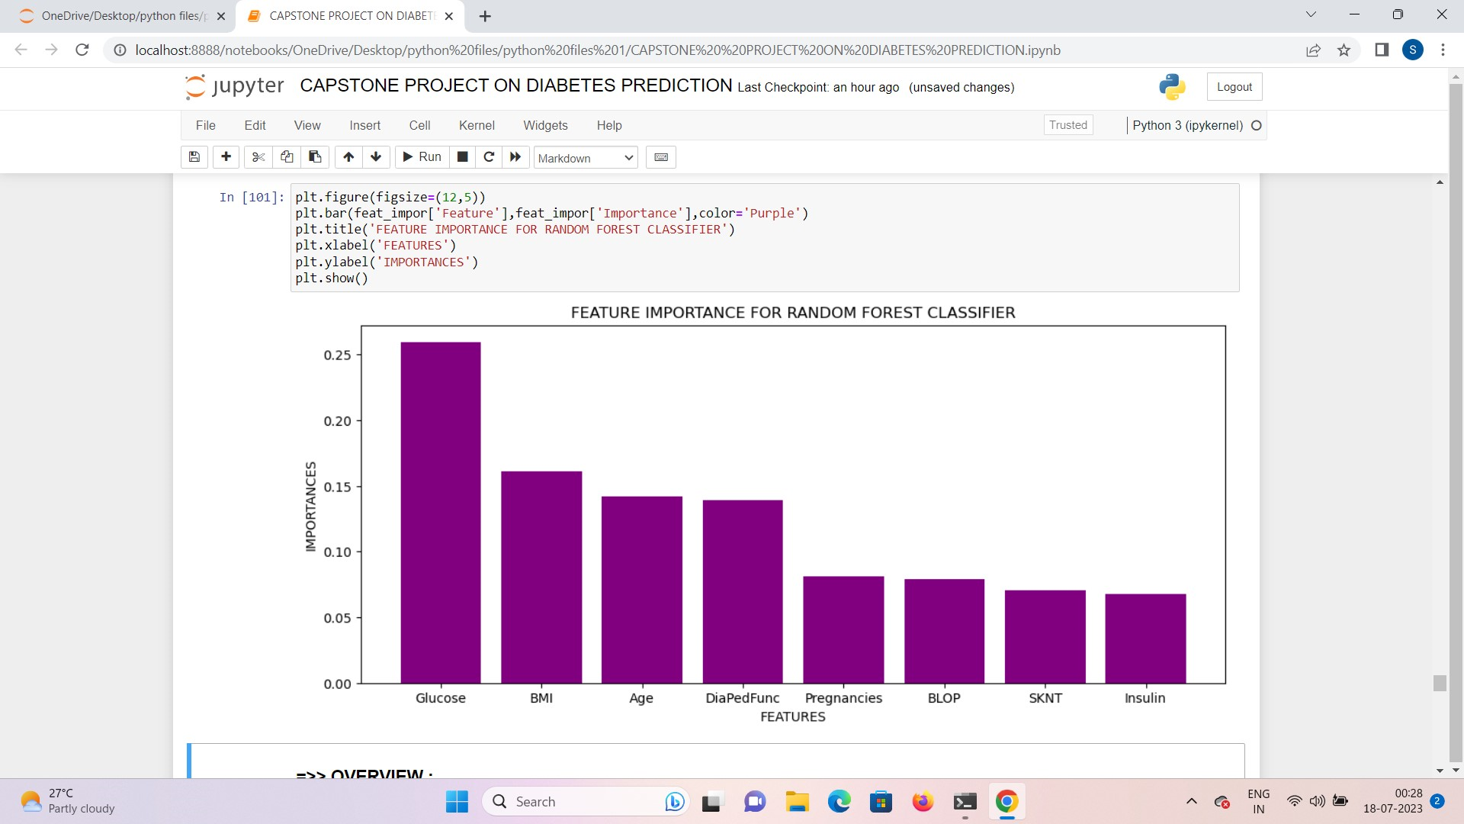
TOP 5 FEATURES INFLUENCING THE DIABETES PREDICTION :
SL. NO. | TOP 5 FEATURES INFLUENCING THE DIABETES PREDICTION PROBLEM
1. | GLUCOSE
2. | BODY MASS INDEX
3. | AGE
4. | DIABETES PEDIGREE FUNCTION
5. | PREGNANCIES

Slide 30
CONCLUSION :
Hereby, I came up with the conclusion that , the integration of machine learning in diabetes prediction has the potential to revolutionize the field of healthcare by enabling early identification of at-risk individuals and facilitating proactive interventions.
From the dataset I can interpret that ‘Glucose’, ‘Body Mass Index’, ’Age’, ‘Diabetes Pedigree Function’ and ‘Pregnancies’, these are the top 5 features , which has the major significance in order to predict the diabetes in females.
Amongst the use of 4 different machine learning algorithms, THE RANDOM FOREST CLASSIFIER , has demonstrated the highest recall rate in diabetes prediction, and it also holds the potential in improving early management of the disease.
In order to address the diabetes prediction problem, companies should collaborate with health care professionals to obtain comprehensive and reliable data .
Companies should leverage machine learning algorithms to build predictive models for diabetes and maintain data privacy and security.

Slide 31
HOW THIS MODEL CAN BE LEVERAGED IN OTHER DOMAINS OR CAN
BE SCALED WITH SOME MORE TWEAKS ?
This model can be leveraged in other domains such as :
FINANCE : Random Forests can be applied in finance for tasks like fraud detection, investment prediction, by training the model on the basis of the historical financial data. So, that it can assess credit worthiness, detect anomalous transactions.
RETAIL AND E-COMMERCE : Random Forests can be utilized here to predict customer behavior , recommendation of the products on the basis of customer attributes, their purchase history and hence, makes easier for the business to take the data driven decisions.
Now, it can be scaled with some more tweaks such as:
Feature engineering and domain specific knowledge
Additional features makes the task more easier for the model to predict the target variable.
Model ensembling can help in improving the overall prediction by leveraging the strength of different algorithms.

Slide 32
THANK YOU!!!

